Slide 1
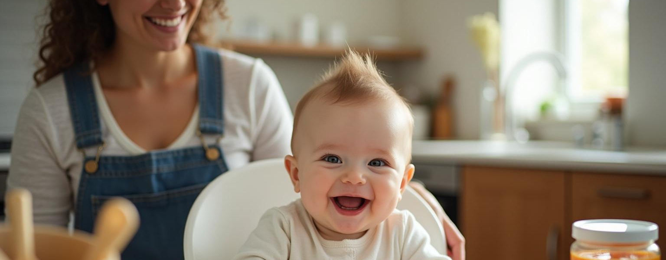
Baby's First Bites
Multimodal Baby Food Chatbot with LangChain
By JASMEET KAUR

Slide 2
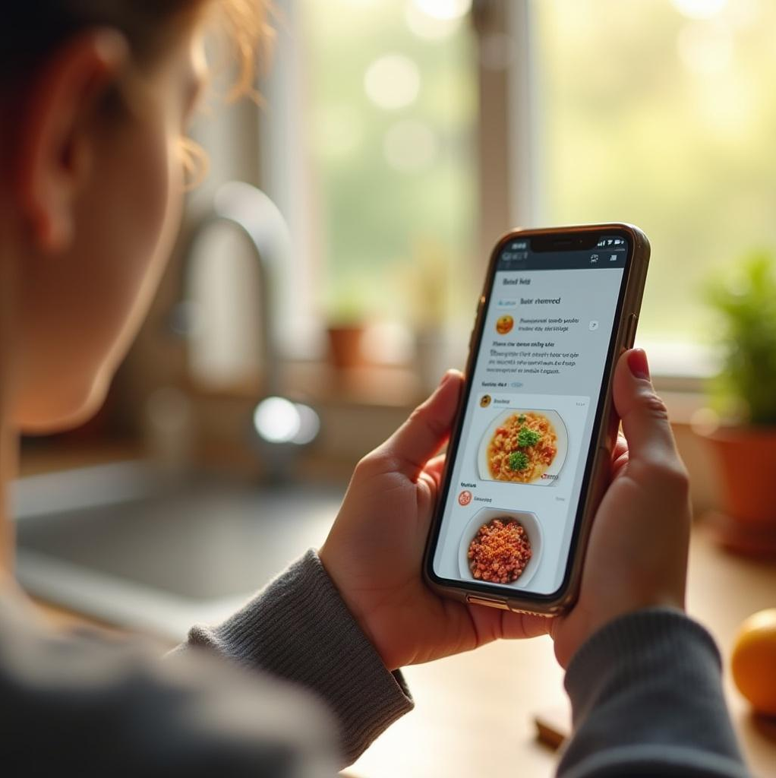
Introduction
Problem:
Consistent confusion and dilemma for parents to introduce delicious solids that will make their baby fall in love with healthy food. Also for parents who can use the app hands free using voice input and ouput.
Solution:
Babys First Bites, a multimodal chatbot designed to assist parents with baby food recipes and nutrition. It combines text and voice inputs to enhance user experience, integrating trusted YouTube videos and reliable resources like the NHS.

Slide 3

Project Overview
Core Features
Video ingestion
- Ingest YouTube videos to extract baby-food content.
- Automatic transcription and chunking for embedding into a vector store.
- Persistent storage of ingested video content.
Conversational Retrieval (RAG)
- Ask questions about recipes, ingredients, and preparation.
- LLM retrieves context from ingested videos and generates structured answers.
- Maintains chat history for context-aware conversation.

Slide 4
Project Overview
Core Features
Recipe-focused answers
Answers include:
- Recipe name
- Age recommendation
- Preparation time
- Ingredients (bullet list)
- Step-by-step instructions
- Avoids irrelevant words like “metadata.”
Voice input & transcription
- Users can record questions.
- Automatic transcription using Whisper.
.

Slide 5
3. Backend / Technical Features
Vector database (Chroma) integration
Store and retrieve embeddings for videos.
Persistent storage to survive app restarts.
Custom prompt templates
Ensure LLM outputs follow a consistent recipe format.
Session state management
Store conversation history in st.session_state.
Maintain chain and vector store across user interactions.
Error handling
Catch exceptions for transcription, TTS, and LLM generation.
Display user-friendly error messages in the chat.
Uses Langsmith for testing evaluation and accuracy

Slide 6
Introduction to Baby's First Bites
The aim of this project is to deliver a conversational AI experience, offering recipes, ingredients, and nutrition advice tailored for parents. This innovative solution facilitates communication in a user-friendly manner.

Slide 7

Significance of Multimodal Chatbot
Implementing a multimodal chatbot transforms how parents access baby food information.
easy recipe navigation
supports voice commands
accessibility and efficiency in meal planning for young families.

Slide 8
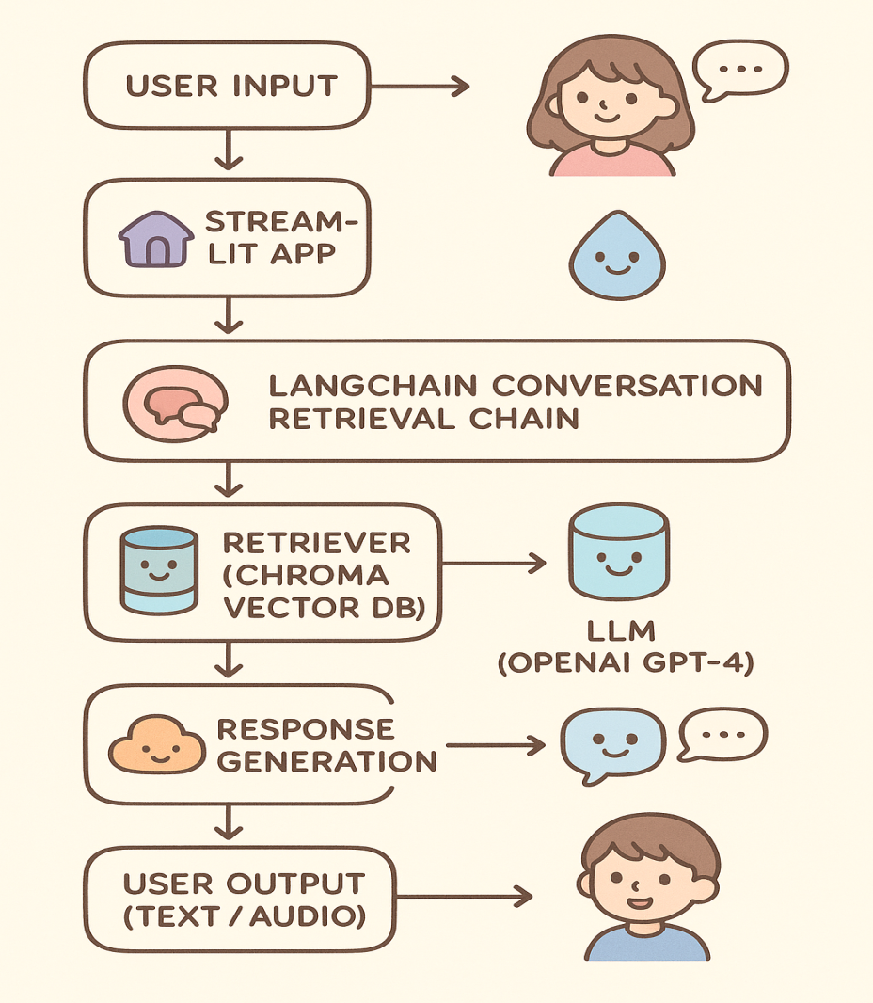

Technical Architecture

Slide 9
Frontend: Streamlit Web App
The user interface is developed using Streamlit, enabling an interactive chat interface that supports both text and voice inputs. This design enhances user engagement while allowing seamless access to information on baby recipes.

Slide 10
Backend Technologies: LangChain and APIs
- The backend utilizes LangChain for advanced conversational capabilities
Integrating various API Whisper and tts-1 for speech recognition and text generation.
This architecture facilitates efficient data retrieval and interaction, ensuring responses are contextually relevant and timely.

Slide 11

Vector Database: Chroma Implementation
Chroma is utilized as the vector database to store and manage recipe embeddings and YouTube transcripts. This setup supports rapid semantic search capabilities, enabling users to quickly find relevant recipes and information based on their queries.

Slide 12
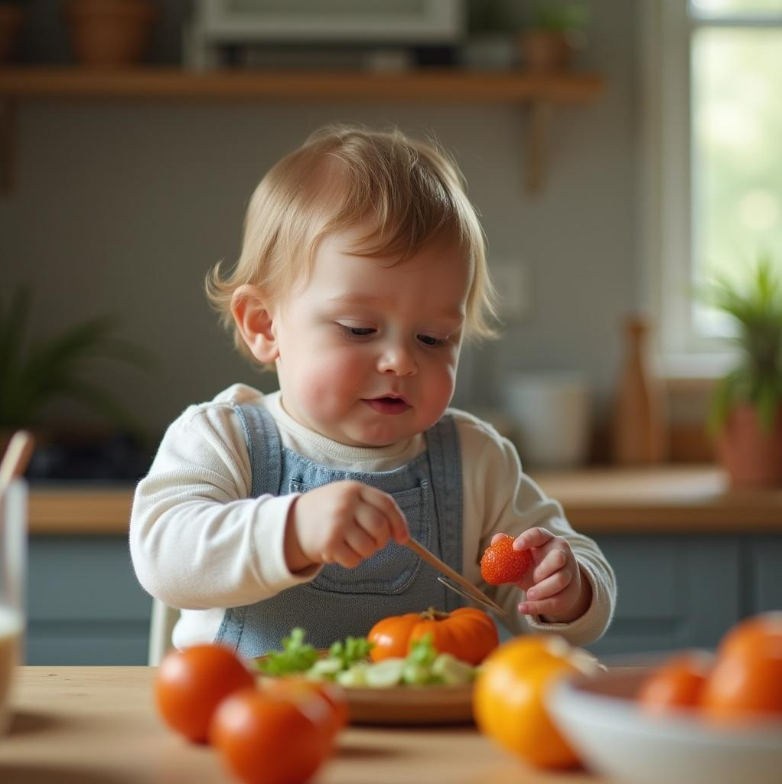
Agent
Handles multi-step reasoning:
Determines whether to retrieve recipes, generate suggestions, or answer directly.
Use tools like:
Uses retriever (RAG) to find most relevant data from vector db
LLM (LangChain/OpenAI) for generating structured recipe responses.
Ensures context-aware, accurate, and safe answers for baby food queries.

Slide 13
Memory
Stores conversation history for context-aware responses.
Implemented using
ConversationBufferMemory:
Keeps track of previous user messages and assistant answers.
Enables follow-up questions without losing context.
Helps agent provide cohesive, personalized recommendations.

Slide 14
Conclusions
Babys First Bites represents
a significant advancement in digital parenting tools.
Combines cutting-edge technology with an understanding of user needs, this chatbot aims to simplify baby food

Slide 15
Challenges
Data scraping
Latency and delays in retrieval

Slide 16
Thank you!

